Slide 1
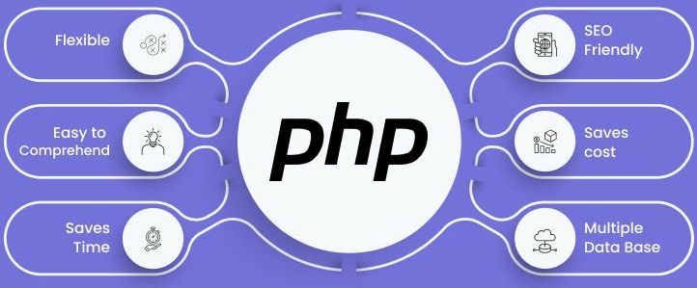

Slide 2
About today…
Security
Form validation
Validate inputs

Slide 3
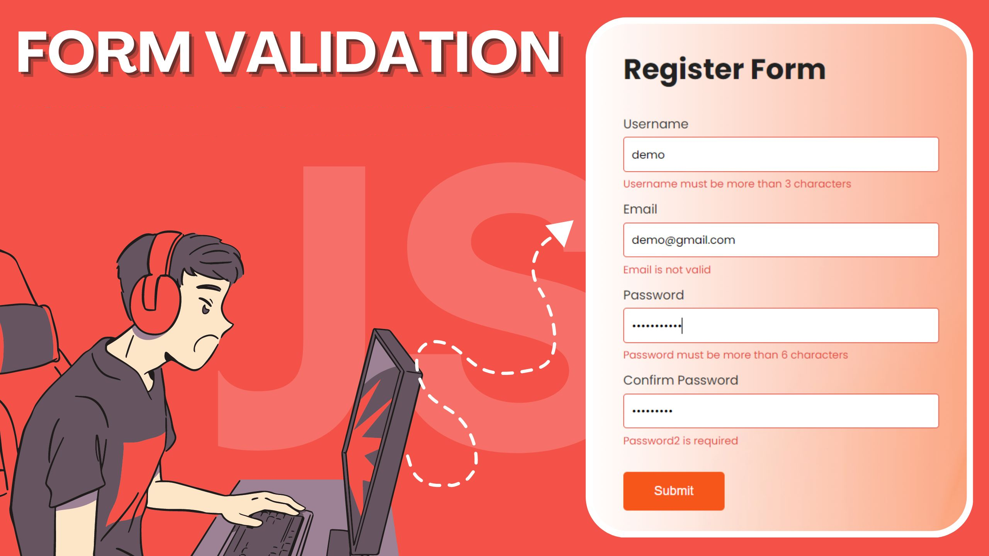

Slide 4
Introduction to Form Validation
What is Form Validation?
The process of ensuring user input meets the required criteria
Why is it Important?
Prevents errors
Enhances security
Improves user experience

Slide 5
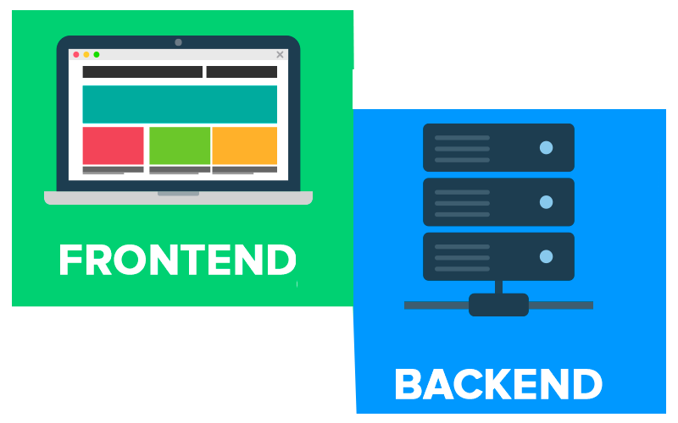
Types of Form Validation
Client-Side Validation
Performed in the browser using JavaScript
Immediate feedback to users
Server-Side Validation
Performed on the server after form submission
Performed on the server after form submission

Slide 6

HTML5 Form Validation
Built-in HTML5 Attributes
required
pattern
min / max
type (email, number, etc)
Example

Slide 7
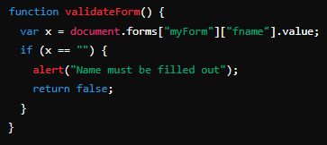
JavaScript Form Validation
Basic Example
Common Validation Checks
Required fields
Length of input
Email format
Number range

Slide 8

Regular Expressions (RegEx) in Validation
What is RegEx?
A sequence of characters that forms a search pattern
Usage in Form Validation
Validating email formats
Ensuring passwords meet criteria

Slide 9
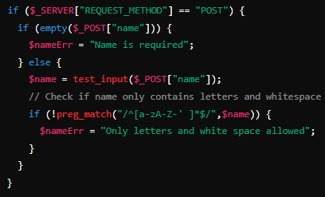
Server-Side Validation
Importance
Protects against bypassing client-side validation
Examples

Slide 10
Error Handling and User Feedback
Displaying Error Messages
Inline messages
Alert boxes
Tooltips
Improving User Experience
Clear, concise error messages
Real-time feedback
Highlighting erroneous fields

Slide 11
Best Practices for Form Validation
User-Friendly Error Messages
Avoiding JavaScript Alerts
Use more subtle and inline messaging
Accessibility Considerations
Ensure screen readers can read error messages
Use ARIA roles and properties
Security Considerations
Always validate on the server-side
Sanitize and escape input data to prevent XSS and SQL Injection

Slide 12


Slide 13

What is form validation?
Name two types of form validation
Which HTML5 attribute is used to make a form field mandatory?
What is the purpose of the pattern attribute in HTML5?
Why is server-side validation necessary?
What should you consider for accessibility when providing error messages?
Which JavaScript function is used to display a message box to the user?
What is the purpose of sanitizing and escaping input data?

Slide 14

Task 1
Create a basic HTML form and apply HTML5 validation attributes
Task 2
Implement client-side validation using JavaScript
Task 3
Enhance user experience by displaying user-friendly error messages

